Slide 1
Community Engagement and Decision Making
the role of local government

Slide 2
what is our role in decision making?
what is community engagement/consultation (are they any different)?
what is our role in facilitating engagement/consultation?
case study – Waikaia Gold Limited, Freshford

Slide 3
The Council’s role is ...
to decide the effects on or of:
groundwater, surface water, the coastal marine area, water conservation orders, soils, river channels, air quality, public access, wildlife, nitrates, natural character, structural integrity, flood risk, drainage, odour, contaminated land, biodiversity, pests, overland flow, hazard management, sustainability, more stuff, less stuff,
to decide whether to notify or not

Slide 4
To notify or not to notify:
High level of public interest does not mean notification should follow
Decision to notify comes from effects assessment and tests in Act
If no evidence of adverse effects then no power to notify …

Slide 5
The Council’s role is not ...
to rule out or ban certain methods
ignore legal obligations and tests
to ignore its duty under the Resource Management Act
to consider applications other than on their individual merits

Slide 6
Community Engagement vs Consultation
engagement
no explicit statutory or legal rules
evolving
plan/policy development
consultation
rule bound
an obligation and function of statue
known boundaries and specific purpose
channel for obtaining or giving information
time restricted

Slide 7
Community…
“it’s not the Council’s function…”
“it’s best to discuss that with the applicant’
“council has determined that you’re not potentially affected”
it’s important to make a distinction between those who have an interest, they may be against ‘the idea’ of exploration and those who may be potentially affected. – it’s important for the Council to make that distinction and for the applicant, but it’s also important not to ignore those interested parties.

Slide 8
ES’s experience of petroleum and mineral extraction
gravel extraction
lignite mining
gold mining – and is rumoured to be increasing
suction gold dredging
petroleum exploration – Stewart Island

Slide 9
Waikaia Gold Limited
alluvial gold mine on the fork of the Waikaia River and Mataura River
the application was received by ES and SDC
abstract (non-consumptive) up to 29,549 m³/day (684,976 m³/month and 5,500,000 m³/year) of groundwater
discharge mine pond dewatering and stormwater
discharge contaminants, namely dust, to air;

Slide 10
Waikaia Gold Limited held a public meeting prior to lodging an application.
they expected public notification
From 18 submissions 9 were in favour of the application and the majority of those 9 parties were attended the public meeting

Slide 11
What are we expecting?
the Waimea Valley Tender Block has been opened up
trying again on old gold sites now that gold prices are high
petroleum exploration in Great South Basin
f**cking

Slide 12
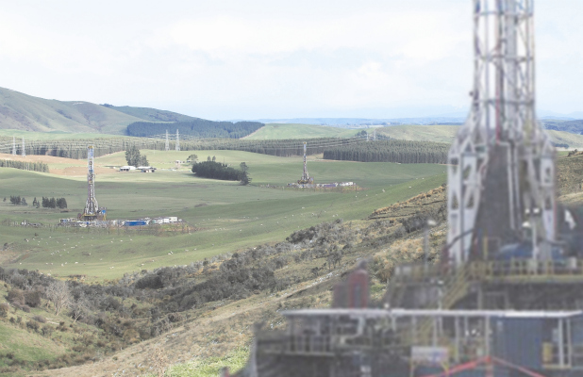
an illustration of what the Waiau Basin could look like if shale gas drilling went ahead – Southland Times Limited

