Slide 1
Chatham Rise Phosphorite Mining – Impact Assessment Challenges
Paul Kennedy and Carmen Taylor, Golder Associates (NZ) Limited
Mike Patrick, CRP & Resource and Environmental Management Ltd

Slide 2
Activity in the New Zealand CMA
Large scale marine developments are not common in New Zealand
Historically this is dominated by oil & gas field development on the continental shelf off Taranaki (Maui, Maari, Tui etc.)
Large scale dredging of port approaches (e.g., Auckland, Tauranga, Lyttelton, Dunedin).
Large near-shore developments/projects such as Clifford Bay, Port reclamation and construction.

Slide 3
Global Marine Environment
Internationally gravel and sand extraction in shallow waters is ‘common’
Interest started in 1960s, due to pressure on resources. Research and exploration includes polymetallic deposits, manganese and sulfide deposits. Today China, Japan and other countries showing significant interest
Currently DeBeers mine diamonds off the coast of Namibia. Anglo-Gold/DeBeers have interests in other marine mining
The Sandpiper phosphate project 120 km off Walvis Bay on the Namibian continental shelf is well advanced. Water depths are at and deeper than 150 m.
Nautilus and Neptune Minerals exploration in the Pacific. Nautilus was until very recently proposing to undertake mining (massive sulfides) at Solowara-1 in the Bismark Sea (PNG)

Slide 4
Activity in the New Zealand CMA
In NZ, sand mining in the near-shore (e.g., Pakari, Kaipara) for sand supplies
TTR Resources and others are exploring for iron sands along the coast of the West Coast of the North Island (<100 m)
There is massive sulfide deposit interest in the Kermadec Trench
The CRP Chatham Rise proposal is the only deep water non-metallic resource being advanced in this part of the world

Slide 5
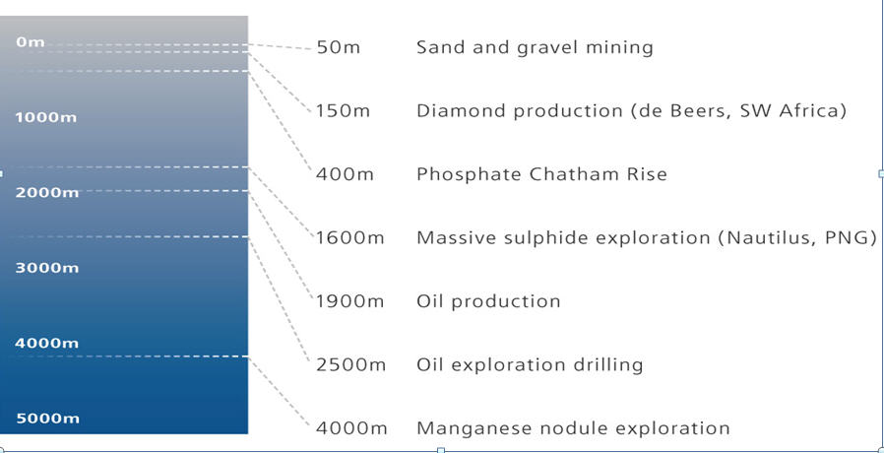
Deep Sea Mining – Extraction Depths
Notes:
In NZ we have undertaken nearshore sand mining for sand supplies e.g., Pakari and Kaipara Harbour
Internationally, gravel and sand mining is common,

Slide 6
Chatham Rise – Prospecting Licence
MPL 50270
Area 4,726 km²

Slide 7
Why Phosphorite?
Globally phosphorite deposits (on land) are a key source of phosphate fertilisers.
New Zealand imports much of its fertiliser (I M t/year mostly from Morocco).
Concerns about cadmium concentrations in imported fertiliser – Chatham Rise has low cadmium

Slide 8
Chatham Rise - Setting
Rise formed in late Cretaceous when NZ split from Gondwana
Nodule deposits formed 11-7 million years ago (Miocene) by phosphatisation of calcium carbonate ooze following a change in ocean circulation patterns (cold water upwelling)

Slide 9
Legislative Framework
Mining activity takes place outside of New Zealand’s territorial sea but within the exclusive economic zone
Mining licence required under section 5 of Continental Shelf Act 1964 (CSA) and environmental conditions can be imposed on the licence
Exclusive Economic Zone and Continental Shelf (Environmental Effects) Act 2012 (EEZ Act):
‘fills the gaps’ that existed under previous legislation
Date of EEZ Act – 3 September 2012
Commencement - either by Order in Council or if provisions have not been bought into force by 1 July 2014

Slide 10
Key Project Work Elements
CRP are working through two processes:
A Mining License Application to Crown Minerals
An Application for a ‘Permit’ to undertake mining on the continental shelf.
Environmental physical and ecological field data collection, information reviews and assessments
Assessment of project infrastructure for mining and shore processing.
Assessment of effects including sediment dredging and disposal including modeling of sediment dispersal and sedimentation

Slide 11
Physical Environment Work Elements
Wave and climate environment (vessel)
Currents, tides (instrumentation deployment)
Water column properties (temperature, turbidity) (water column strings, seabed deployments)
Seabed characteristics
Sampling using grab and box cores
Geotechical data (CPTs etc.)
Geophysical surveys (bathymetry, subsurface)
Seabed geology and geochemsitry
Assessment of sediment dredging and disposal including modeling of sediment dispersal and sedimentation

Slide 12
Ecological & Environmental Work Elements
Key faunal groups; seabirds, marine mammals
Benthic infauna and epifauna (grab samples, photo survey, ROV)
Planktonic, pelagic biota
Fisheries
Food chain interactions, dependencies
Water quality changes, sedimentation

Slide 13
Research History
One of the most intensely studied parts of the NZ continental shelf, with work undertaken since 1952
Sonne Cruise 1978, Valdivia Cruise 1981
NIWA/MAF research cruises.
Recent NIWA/MAF work has included
Water column properties, phytoplankton
Fisheries effort, trawls, species
Seabed ecology, trophic model

Slide 14
Sonne & Valdivia Seabed Sampling

Slide 15
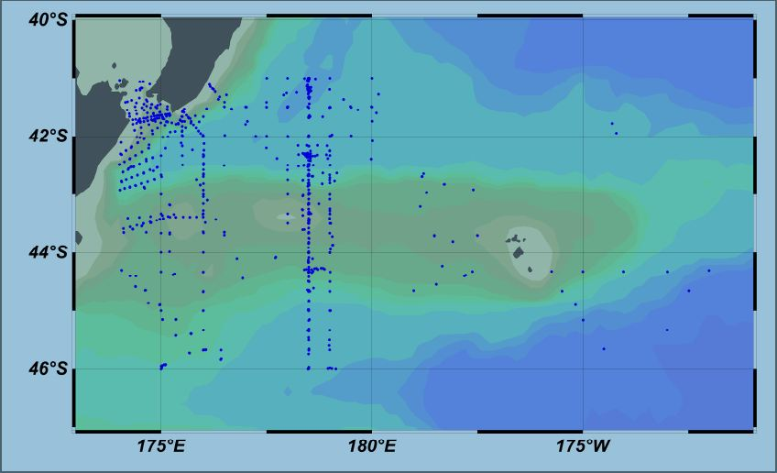
CST - Casts
Assessment of sediment dredging and disposal including modeling of sediment dispersal and sedimentation

Slide 16
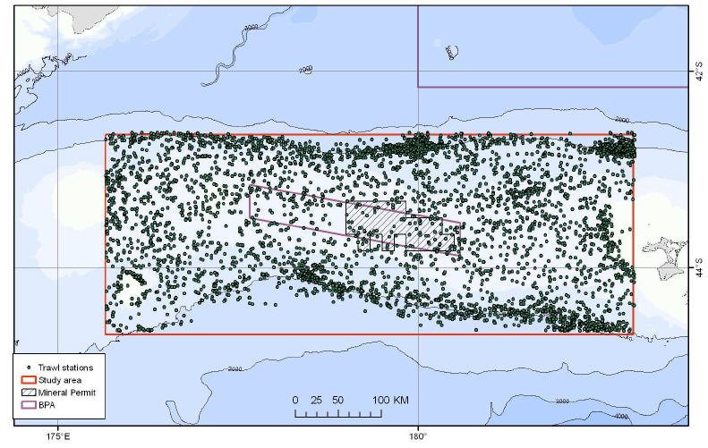
Fisheries – Trawl Stations

Slide 17
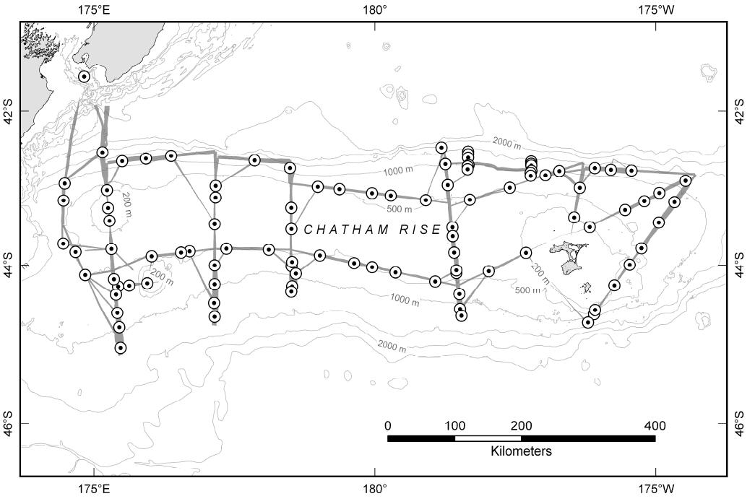
Oceans Survey 20/20
Multi-beam transects
Benthic sample stations

Slide 18
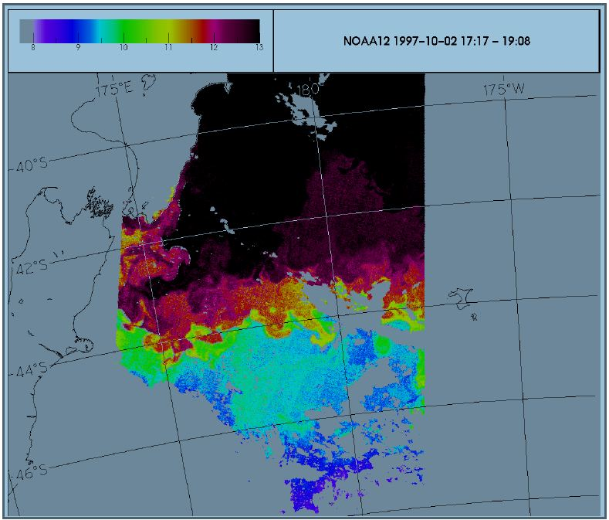
Sea surface temperature

Slide 19
Current Research
Initial reviews undertaken on the basis of prior research
Research priorities identified and four Voyages with Dorado Discovery undertaken in Dec 2011, Feb and March/April and April 2012:
Core site information (bathymetry, sediment structure)
Geotechnical information for mining ‘design’
Benthic ecology (R.O.V, high res photos, grab and core samples)
Sediment characteristics and phosphorite data

Slide 20
EIA Challenges
The first set of challenges arise in getting the information needed for preparing an EIA:
Distance and water depth
Sea state
Time – it takes over an hour to take a single grab or boxcore seabed samples, the R.O.V takes hours to launch and retrieve, and travels at 0.5 m/second .
Massive data evaluation (over 86,000 images) from DD cruise 2.

Slide 21
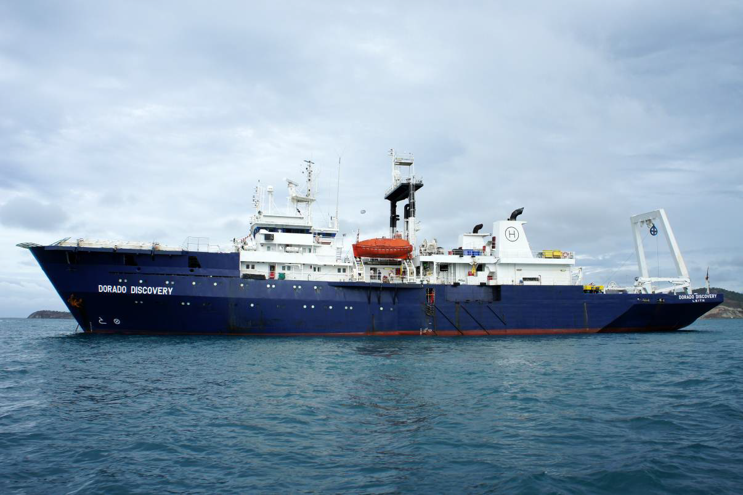

Slide 22
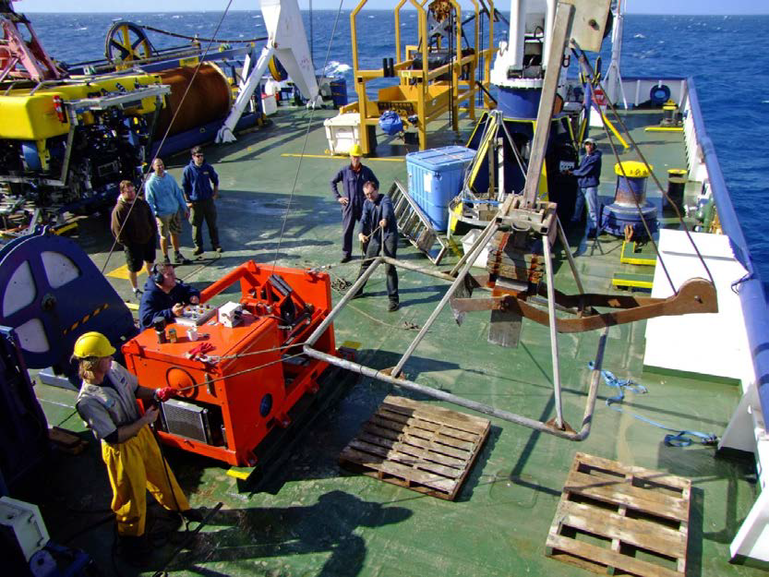
Ecology

Slide 23
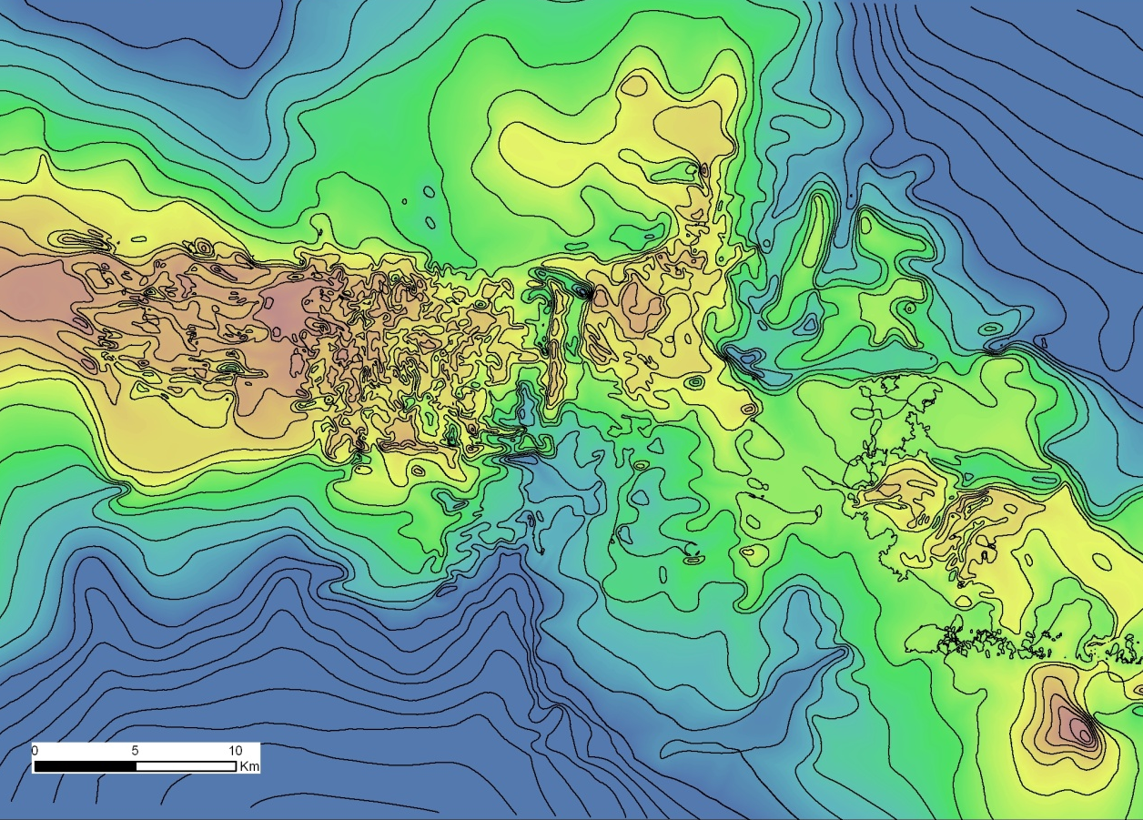
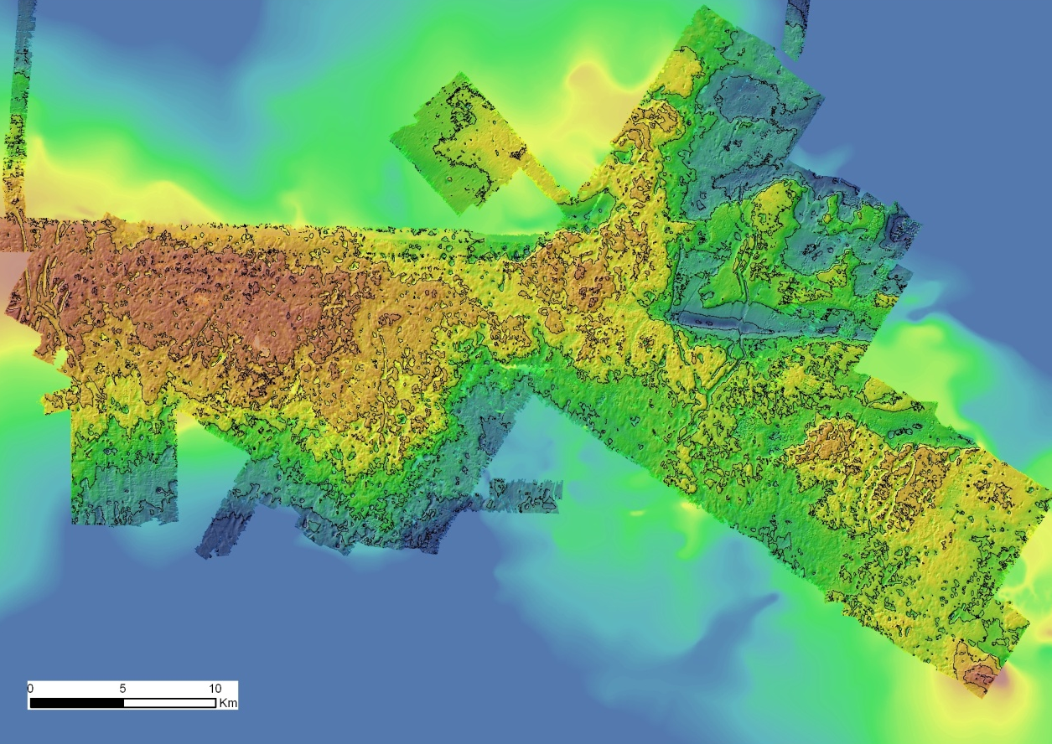
Seabed
Old bathymetry
New bathymetry

Slide 24
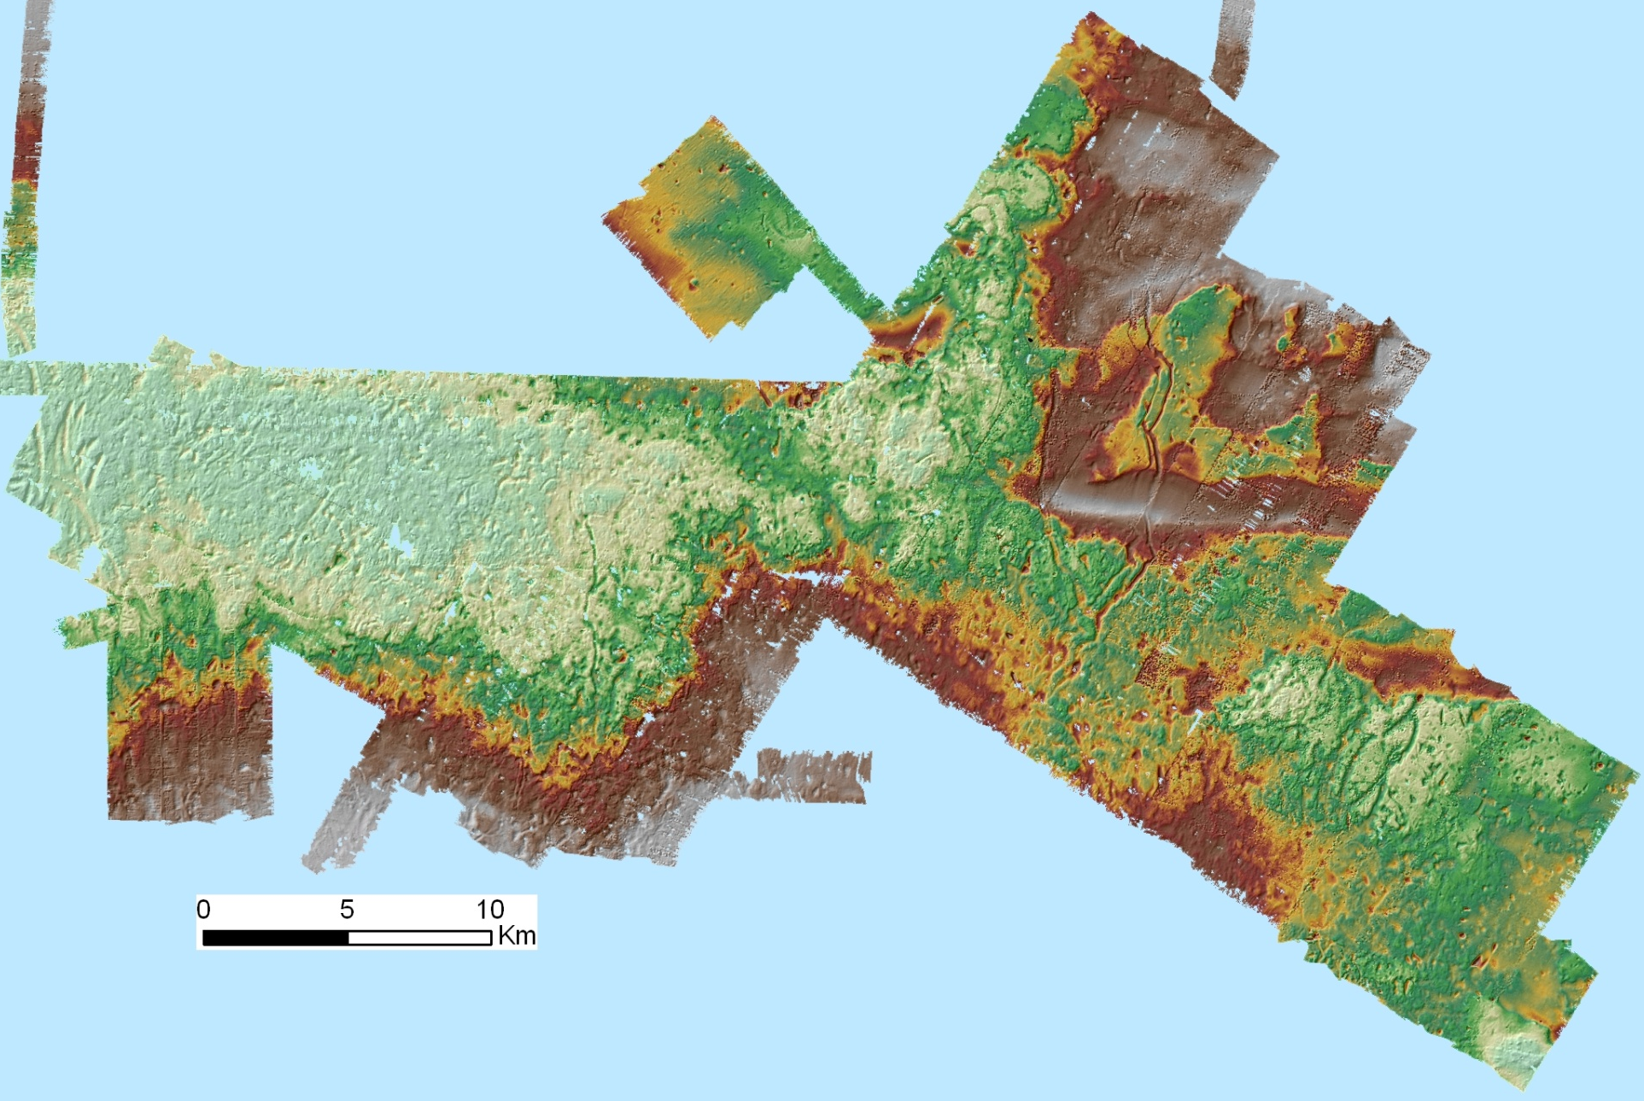
Seabed
plateau
saddle
plateau
Multibeam swath bathymetry data

Slide 25
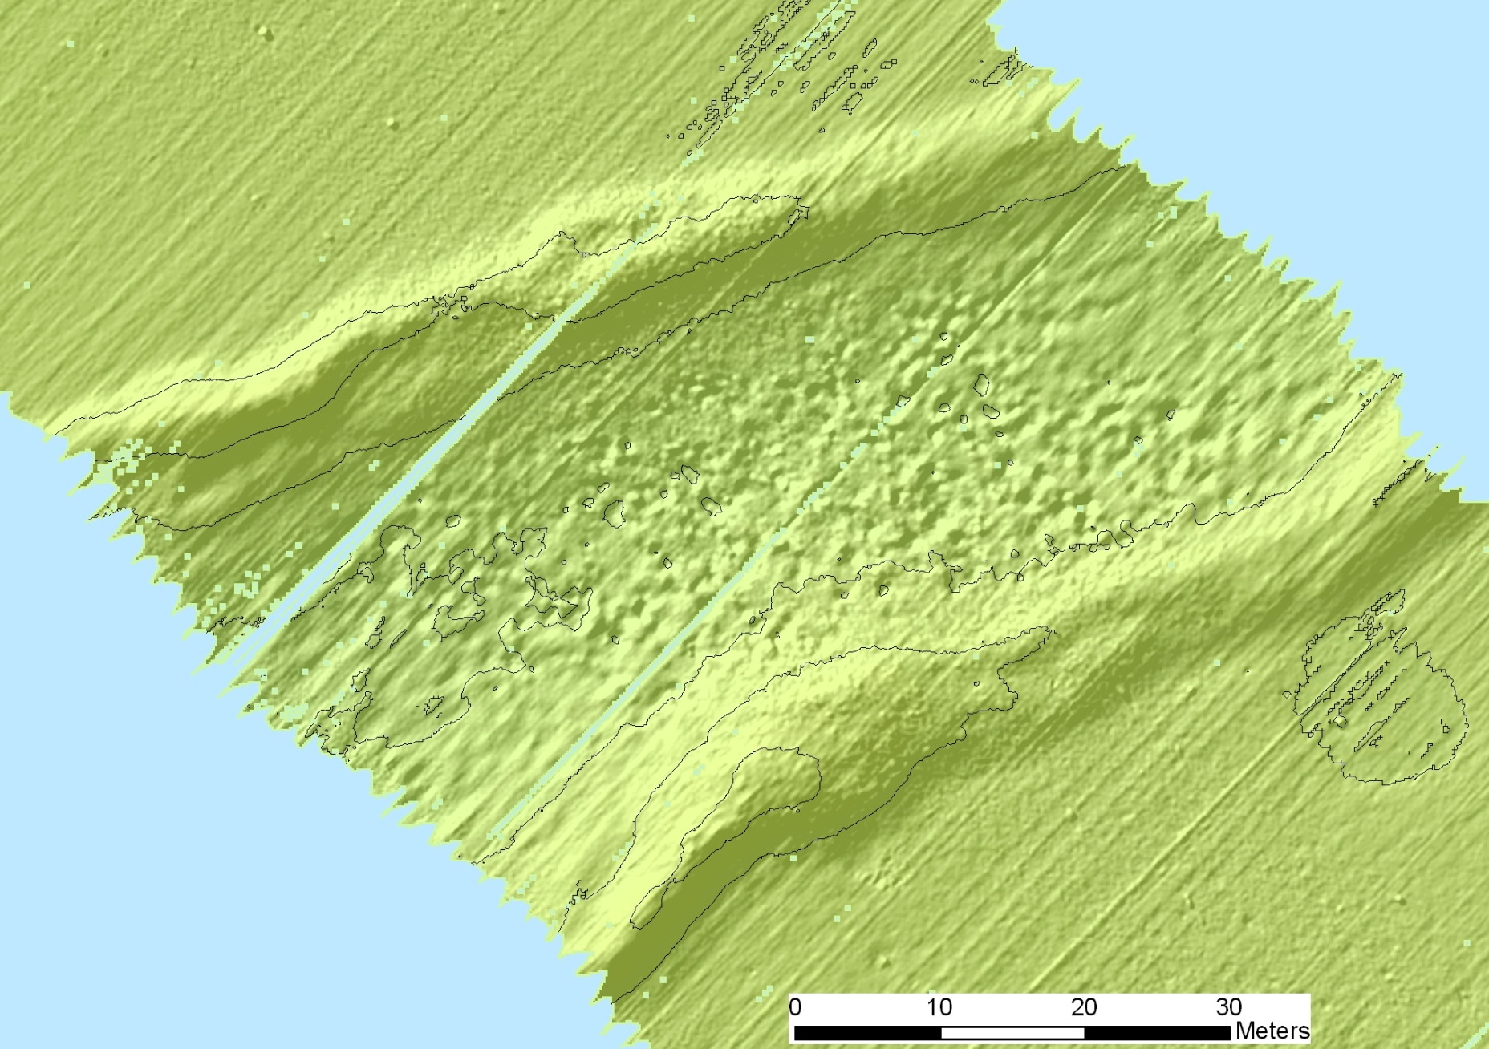
Iceberg furrow
lateral ridge
bioturbation features
lateral ridge

Slide 26
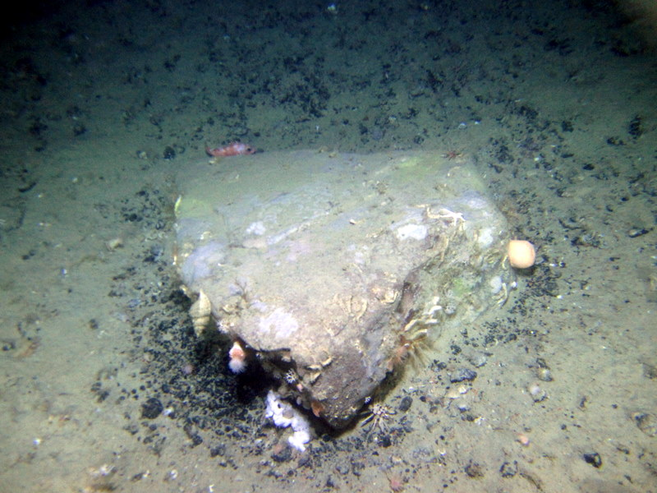
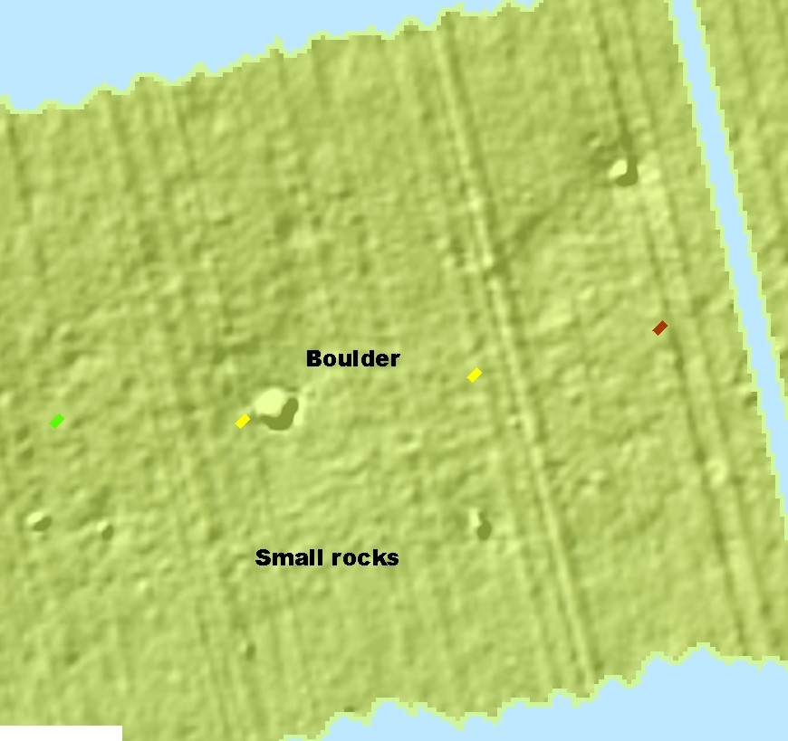

Slide 27
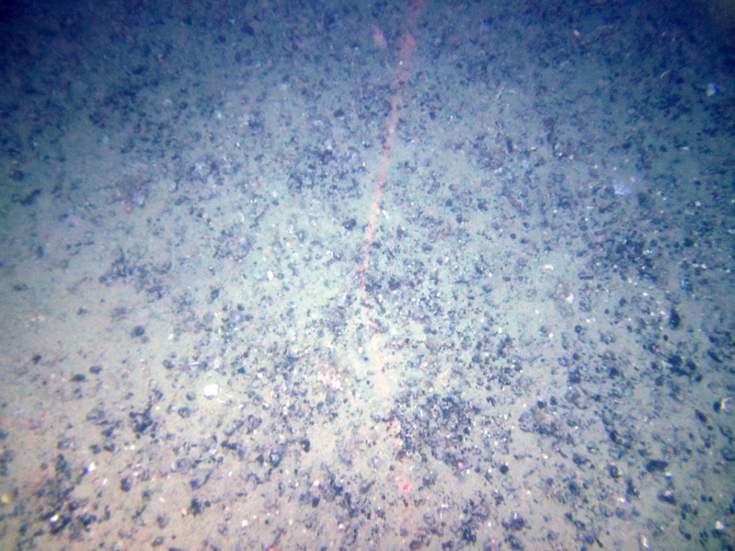
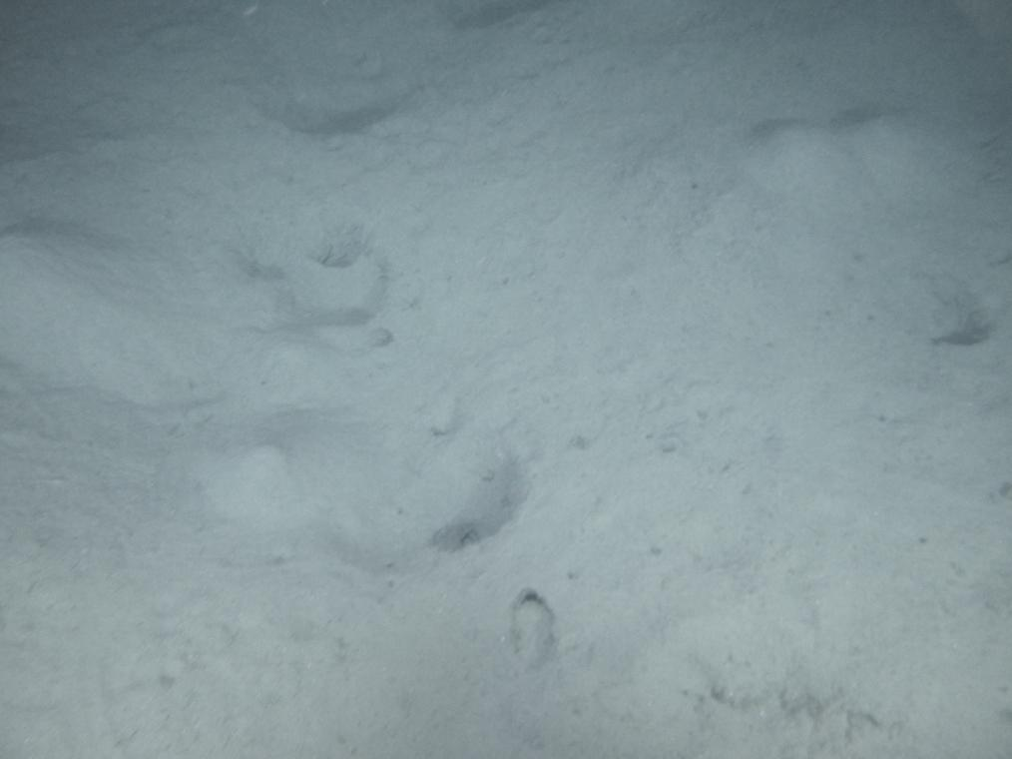
dense medium-sized nodules
pits & burrows

Slide 28
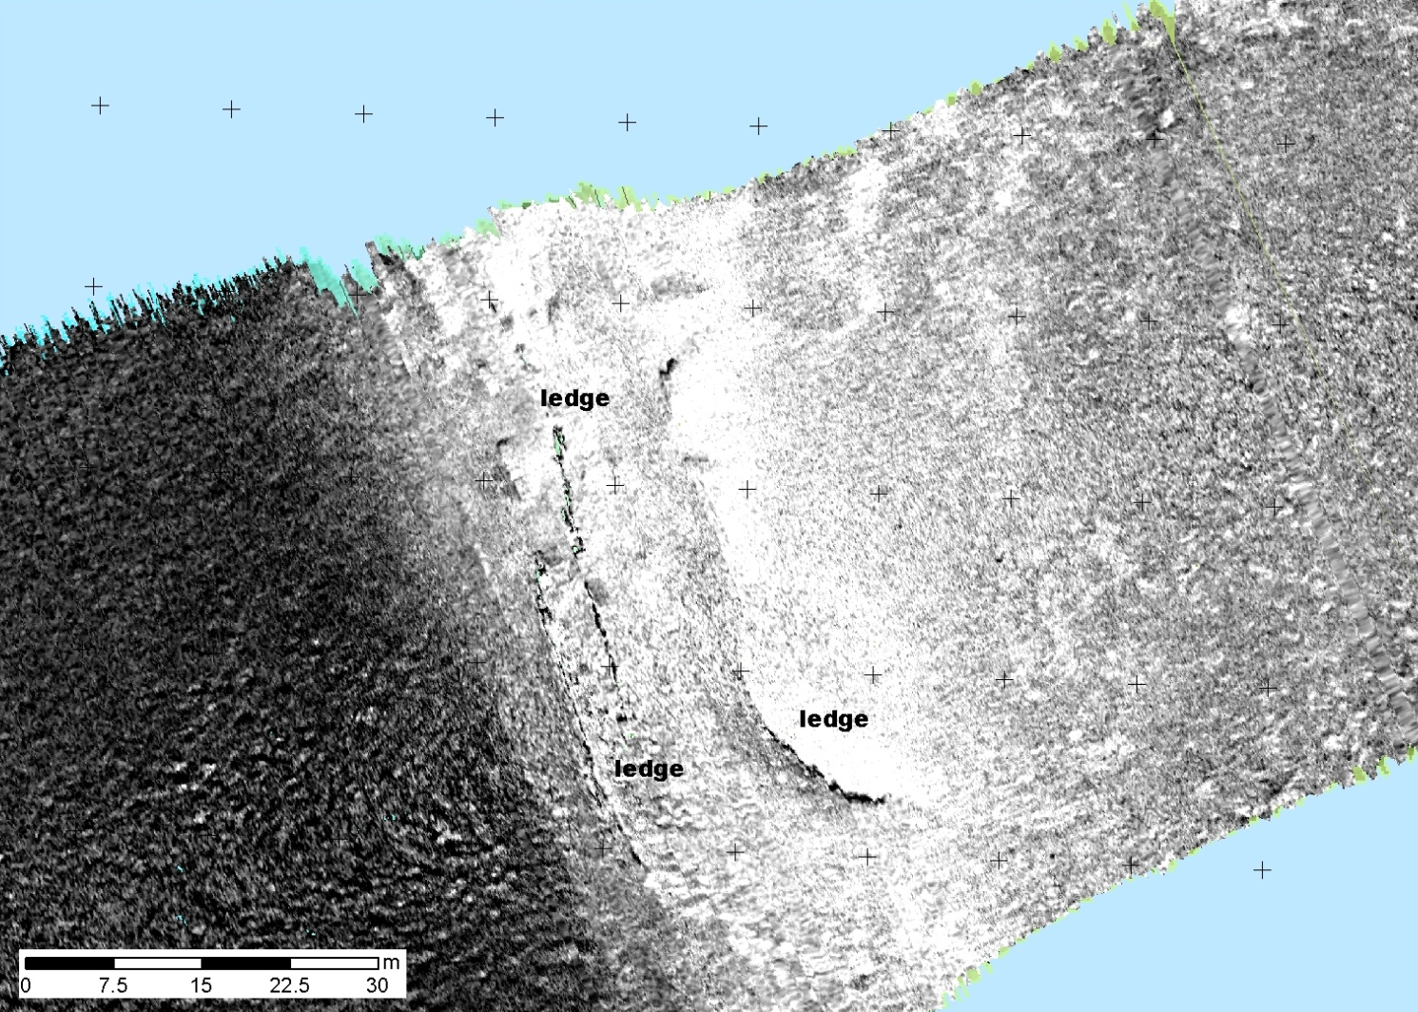
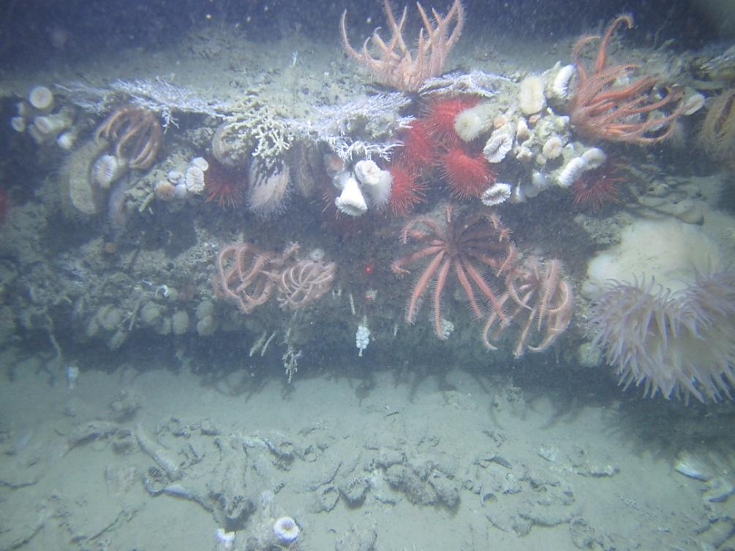

Slide 29
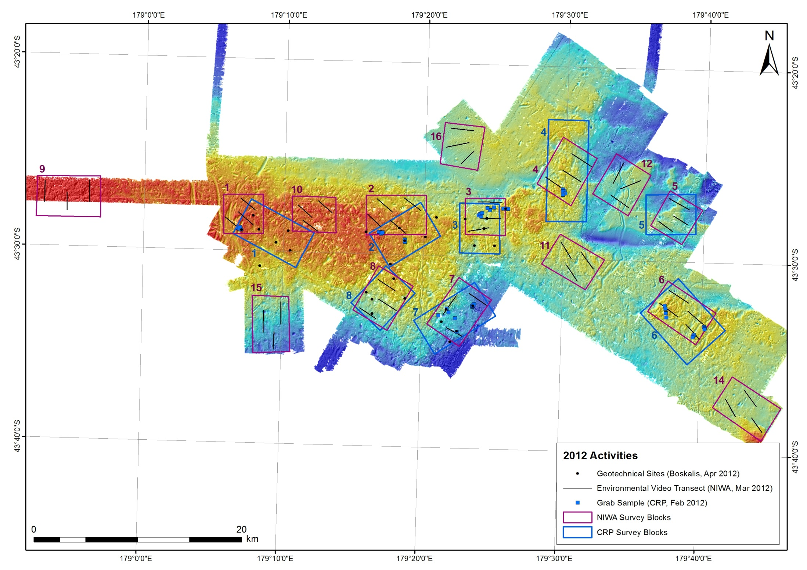

Slide 30
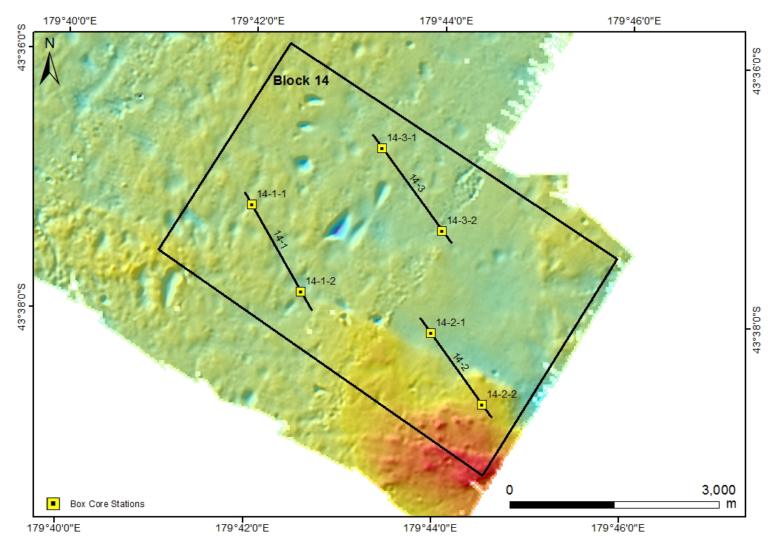

Slide 31
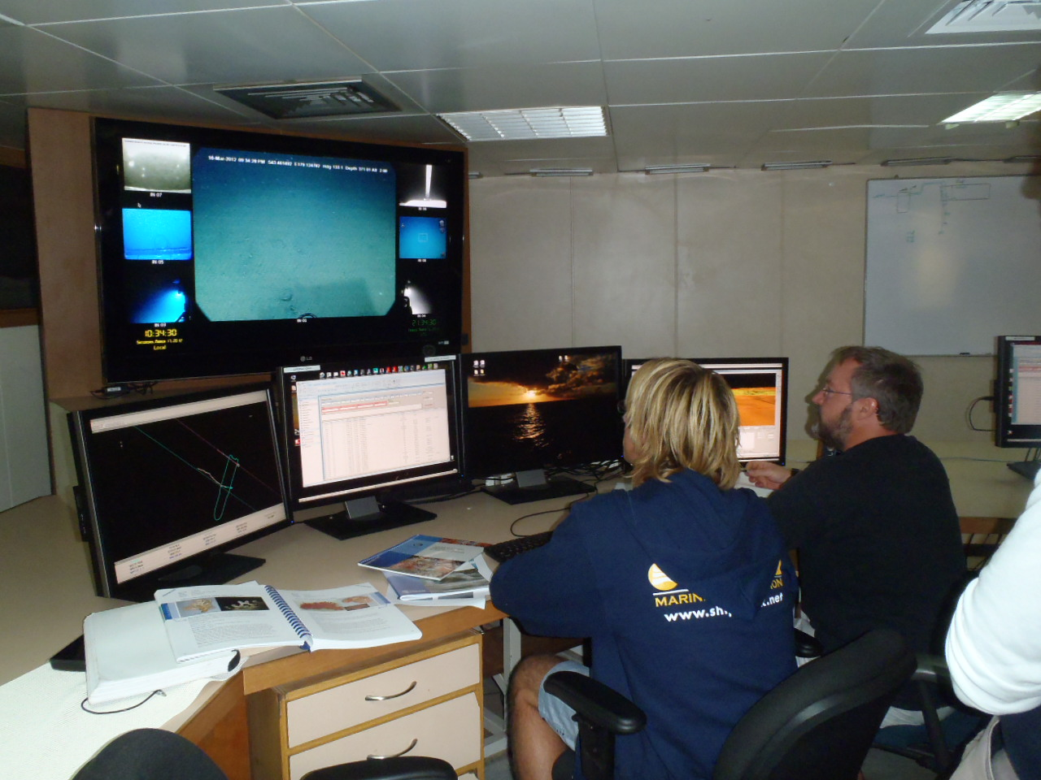

Slide 32
Legislative Framework

Slide 33
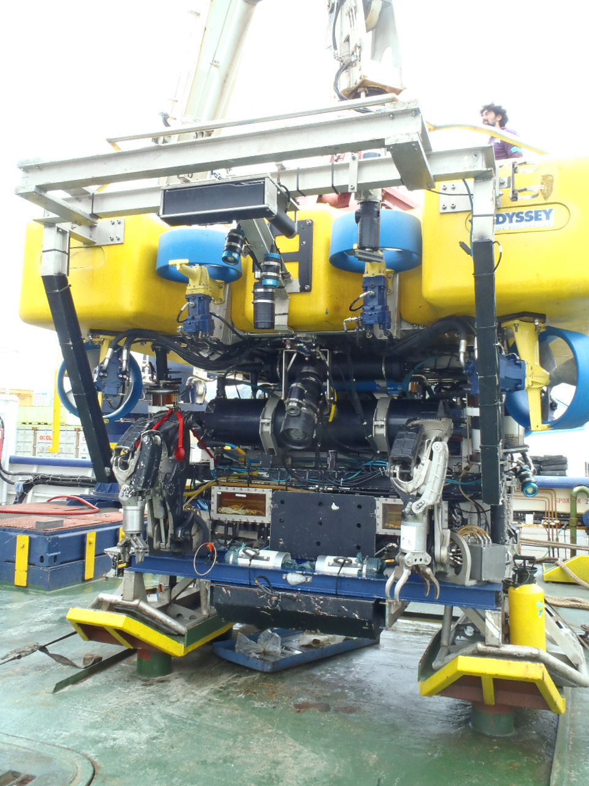

Slide 34
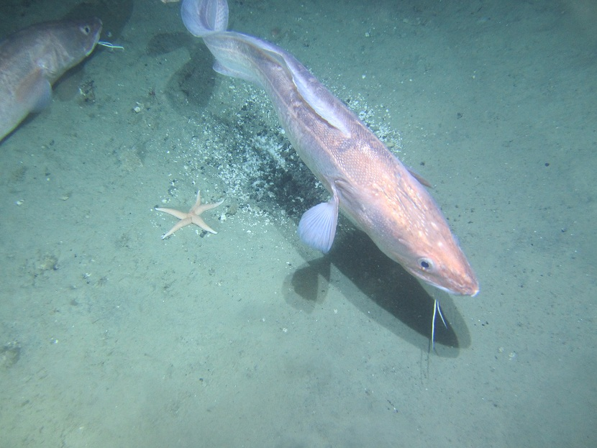

Slide 35
EEZ Act – Natural Resources Management Approach
Not dissimilar to RMA
Approach includes:
Regulation will specify what activities are permitted, discretionary or prohibited. Chatham Rise phosphorite mining will be discretionary
Marine consent must be sought for discretionary activities
Applications for marine consents require an impact assessment
EPA will process applications
Applications will be publicly notified
Decision appeal rights only on points of law

Slide 36
Legislation - EEZ Act
Purpose is to “promote the sustainable management of the natural resources “ of the EEZ and continental shelf (section 10(1))
Sustainable management (section 10(2)) is defined in a manner similar to the Resource Management Act 1991 (RMA), except it does not include physical resources, communities, social and cultural well-being

Slide 37
EEZ Act – Impact Assessment
Section 39 identifies that impact assessment must include:
Activity description
Current state of the environment (attributes, values etc)
Actual and potential effects on the environment, including ‘existing interests’
Potential affected existing interests, consultation undertaken and any written approvals provided
Alternative locations or methods
Measures to avoid, remedy or mitigate adverse effects
Reflects international impact assessment principles and the RMA’s requirements for AEEs

Slide 38
EIA Assessment Framework
The Assessment has been undertaken as if it was a project within the CMA being processed through the normal RMA hearings processes. The Assessment is being carried out using other international principals developed within frameworks such as:
The range of relevant New Zealand Acts (e.g., Conservation Act 1987, Marine Mammals protect Act 1978, NZ Biodiversity Strategy) – and their interface with the new legislation
The range of international conventions:
Marpol 73/78, Bonn Convention (migratory species), Rio Convention on biodiversity (1992)
United nations Convention on the Law of the Sea (1982)

Slide 39
EIA Assessment Framework
The AEE will follow the guiding principals in - The International Marine Minerals Society Code for Environmental Management of Marine Mining (A set of environmental principals). There are 11 operating guidelines for companies who adopt the Environmental Code. These are:
Responsible and Sustainable Development.
Environmentally Responsible Company/Entity Ethic.
Community Partnership.
Environmental Risk Management.
Integrated Environmental Management.
Company / Entity Environmental Performance Targets.
Review, Improvement and Updating of Environmental Policies and Standards.
Rehabilitation and Decommissioning.
Reporting and Documentation.
Environmental Data Collection, Exchange and Archiving.
Performance Reviews.

Slide 40
The Project
How will mining occur?
What will be mined?
What will be returned to the seabed?
Development of a mining plan
What is the fate of the disposed sediment, in terms of sedimentation and dispersal?
How does the project impact upon the natural environment of the Rise?
How does the project impact upon commercial resources (e.g., fisheries)?
What mitigation and monitoring will be undertaken?

Slide 41
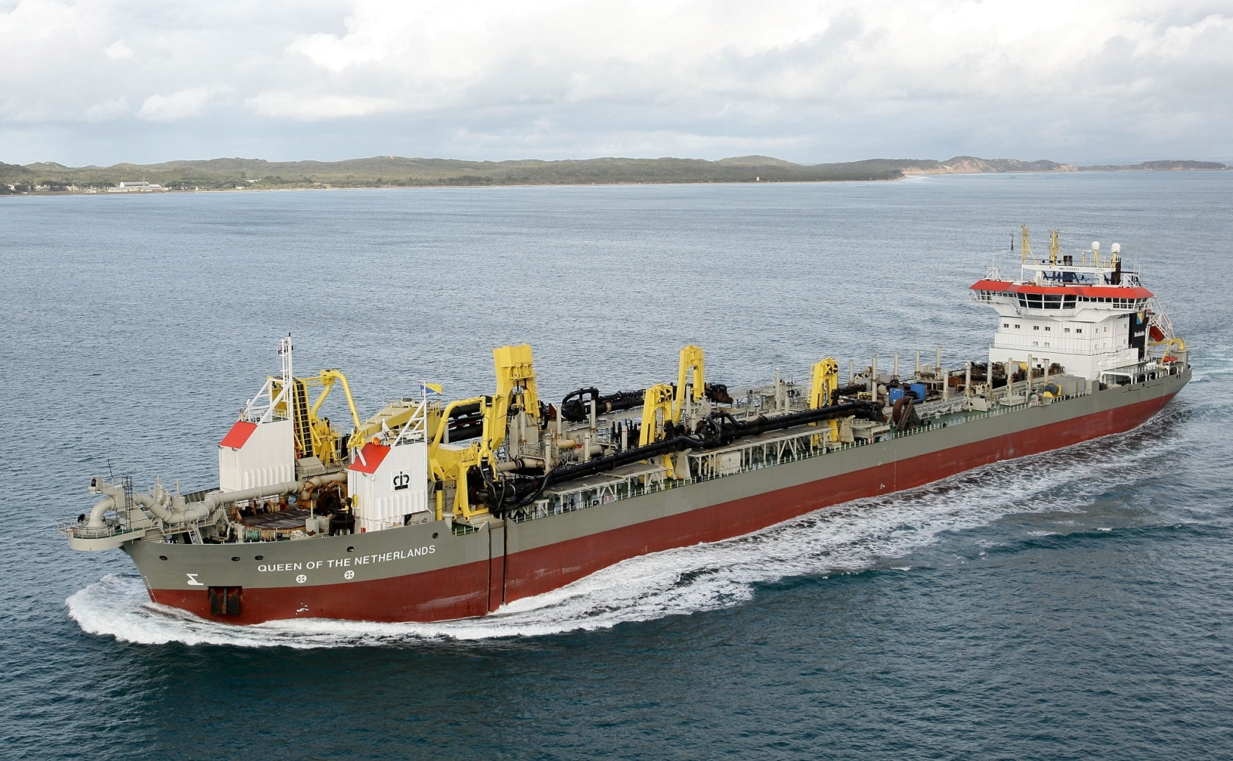
Project Design Concept Conventional trailing suction hopper dredge

Slide 42
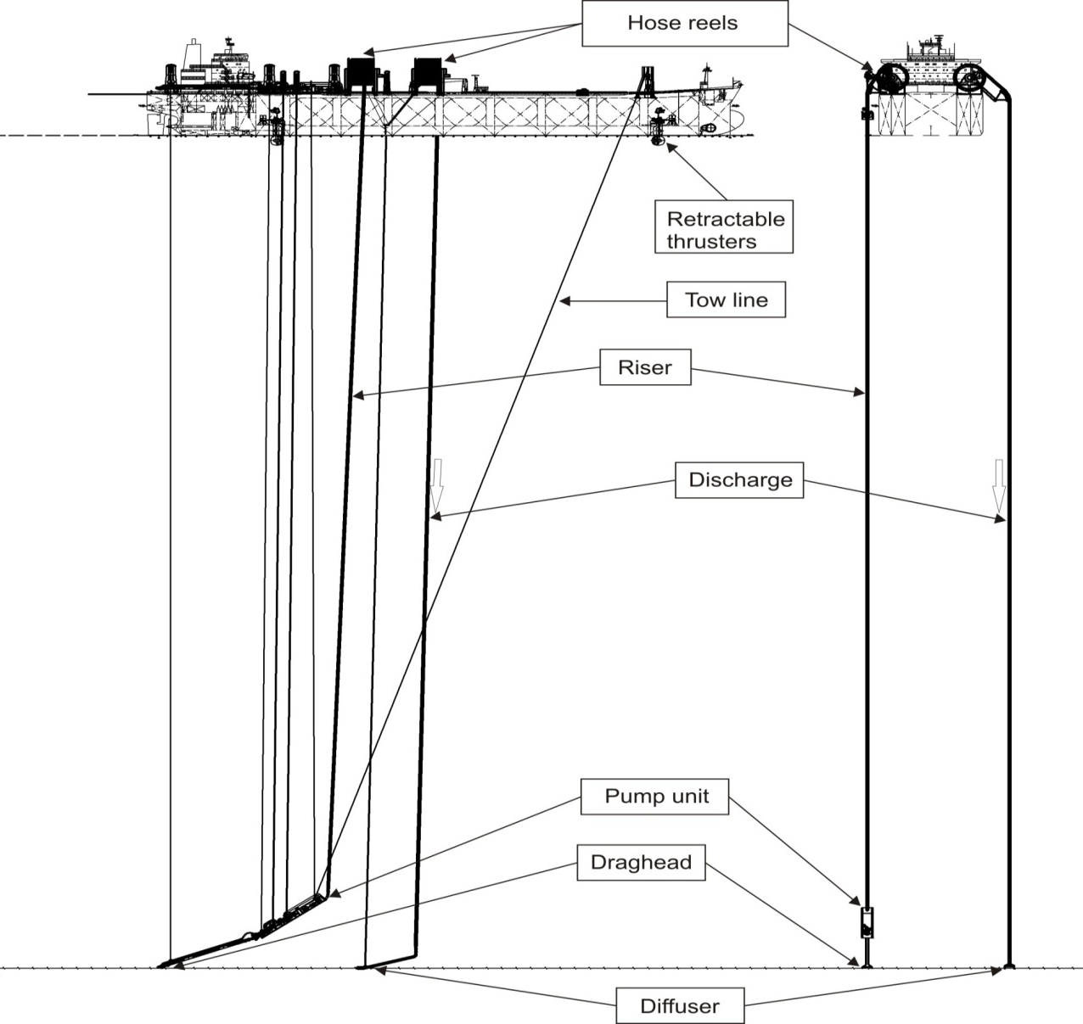
Project Design Concept Flexible dredge head and riser and sinker system with disposal at seabed

Slide 43
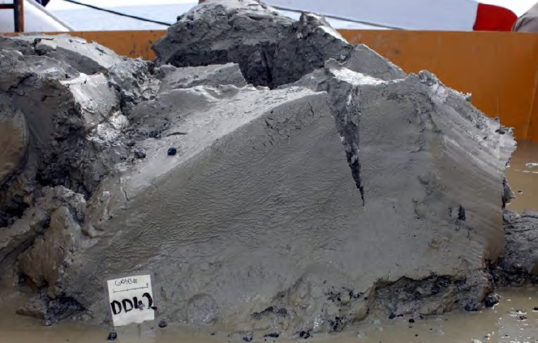
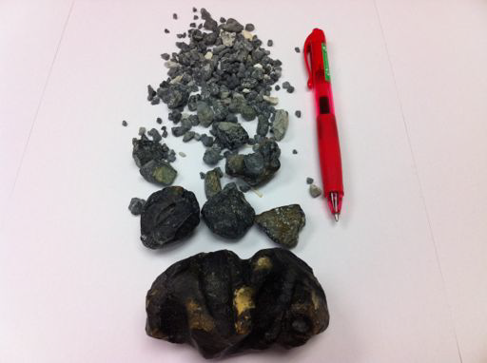
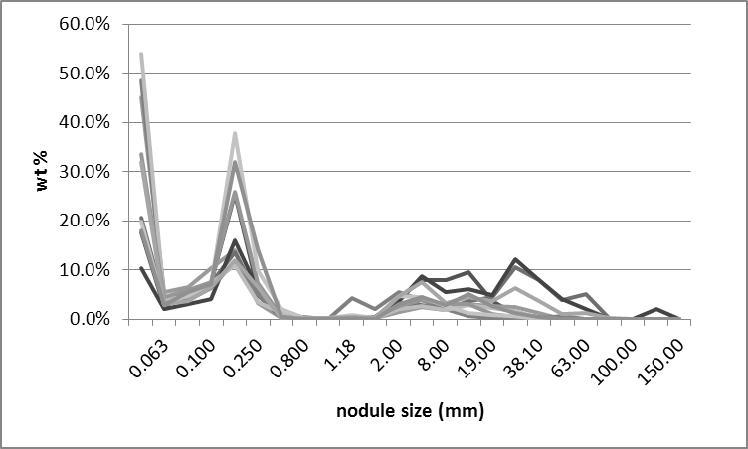
On-board Processing
Material >2 mm retained
Photos: S. Nielsen

Slide 44
Challenging Practice & Science
The second set of challenges include:
Preparing an EIA while new environmental management legislation is ‘evolving’
Developing the science and information to provide the information required by the Legislation when the Rules aren’t developed.
Undertaking consultation and stakeholder engagement within a legislative environment that all parties are learning about
Understanding and communicating the issues relevant to the project as many stakeholders distract from real issues to red herrings

Slide 45
Challenging Practice & Science
Delivering an EIA with quality science – many projects battle the issue of technical adequacy:
Developing an understanding of the seabed environment
Mapping habitat and developing a mine plan that meshes
Understanding recolonisation and sedimentation
Understanding how the various components of the Rise ecosystem interact
Where issues are complex using best science to provide answers to questions and using peer review to ensure science is maintained at its best.

Slide 47
Thanks
To:
Everyone associated with the CRP project team for work undertaken to date
NIWA staff who are providing technical support for the EIA
The team from Boskalis Westminster NV & Deltares who are providing key project design inputs and undertaking modeling of disposal sediment

