Slide 1
Lessons from Think Big NZAIA Conference 2012
Geoff Bertram
Institute for Governance and Policy Studies
Victoria University of Wellington
11 November 2012

Slide 2
1. Beware of vested interests shouting huge numbers
New Zealand’s greatest psychological weakness is gullibility when faced by promoters
Any promoter’s interest lies in making the strongest case possible for their pet project
They will be honest and open only in a policy environment where honesty and openness pay and where naked propaganda doesn’t pay off
New Zealand is not such an environment

Slide 3
Beware also of consultants closely linked to sectors seeking government support
Barker: “The minerals, oil, gas and coal being produced in New Zealand have a value of about $4,500 million per year, and contribute more than $2,000 million to exports. Potential exists to maintain and expand the range and value of what we produce.”
Total exports are $47 billion. Barker’s all-up total for minerals is 4% of that. Don’t get too excited – “potential to expand” could be another1% or 2%...

Slide 4
The figures on mineral value from Barker (2008) are a classic example
“The metallic mineral potential of New Zealand has a gross in-situ value of more than $140 billion with lignite alone at least an additional $100 billion. In addition, New Zealand has good potential for the discovery of new oil and gas resources”
Richard Barker, The Natural Resource Potential of New Zealand, March 2008, http://www.minerals.co.nz/pdf/Natural_Resource_NZ_web.pdf , p.1.

Slide 5
How big a discount should you put on promoters’ figures?
Take Barker => Straterra => MED’s (2010) $200-billion-odd figure for the “value of New Zealand‘s onshore minerals excluding hydrocarbons” (and also apparently excluding coal)
Compare that with Statistics New Zealand’s valuation of non-petroleum mineral resources including coal under the UN System of Environmental-Economic Accounts (an offshoot of SNA)*
Statistics New Zealand got $1 billion total (0.5% of Barker/Straterra/MED)
Royalty rates on mining tend to hang around the 1% of gross sales which makes this pretty credible
The other 99% goes to the costs of exploration and extraction
And that’s without counting the spillovers and non-monetised costs
Statistics New Zealand, Environmental Accounts Series: Mineral Monetary and Physical Stock Account 1994-2000, available at http://www.stats.govt.nz/publications/nationalaccounts/minerals/interpretation-of-the-mineral-stock-account.aspx , p.6 and Table 4.4 p.16; and (for coal) Energy Monetary Stock Account 1987-2001, Table 5.4 p.21.

Slide 6
In relation to Schedule 4 back in 2010
The industry [Straterra] and MED claimed that $80 billion of minerals were in Schedule 4, of which they were proposing to open up access to $20 billion.
0.5% of that is $100 million – not per year, but a total one-off present-valued sum for all time
That’s $36 per head for 2.8 million registered voters. Period.
So the protesters’ instincts were sound when 40,000 of them marched down Queen Street even if most of them could not do the above calculations. Memories of Think Big?

Slide 7
As I wrote at the time*
“Barker’s figures are actually for gross sales revenue, which he calculates by taking an estimate of the volume of recoverable metals or other products, multiplying this by the current market price of each, and adding up the results, with no allowance for costs of exploration, development, extraction, decommissioning, and rehabilitation, nor for environmental and other external costs of mining. The result is a number which is large but economically meaningless, because it does not represent the real value of the resource as an asset of the nation. The same criticism applies to the figures in the two GNS scientific studies relied on by MED.”
Geoff Bertram, Mining Economics and the Conservation Estate, report for Forest and Bird by Simon Terry Associates Ltd, September 2010 http://www.geoffbertram.com/fileadmin/Mining%20Economics%20and%20the%20Conservation%20Estate%20main%20text.pdf and http://www.geoffbertram.com/fileadmin/Mining%20Economics%20and%20the%20Conservation%20Estate%20appendices.pdf p.5.

Slide 8
and
“Confusion of potential sales revenue with the value of the underlying resource explains why Barker‘s number, relied on by the Government in its [2010] discussion paper, is so much higher than any credible economic valuation of New Zealand‘s mineral resource endowment, and greatly overstates the benefits to be secured from extraction of the total mineral resource.”
Geoff Bertram, Mining Economics and the Conservation Estate, report for Forest and Bird by Simon Terry Associates Ltd, September 2010 http://www.geoffbertram.com/fileadmin/Mining%20Economics%20and%20the%20Conservation%20Estate%20main%20text.pdf and http://www.geoffbertram.com/fileadmin/Mining%20Economics%20and%20the%20Conservation%20Estate%20appendices.pdf p.6.

Slide 9
Three key features of mining in New Zealand
Limited size of most onshore mineral deposits in New Zealand, compared with the enormous scale of, say, Australian ore bodies. This means a relatively short life-span for a typical New Zealand mine.
Potential conflict between the depletable nature of mining and the sustainable nature of other, potentially competing, commercial activities in the conservation estate such as tourism, which rely upon the preservation of landscapes and ecosystems for non-consumptive use by visitors, and for purposes of national branding in overseas markets. New Zealand‘s small geographical extent (compared in particular with Australia) makes it relatively difficult to find locations where large-scale extractive activity can proceed with no economically-detrimental environmental spillovers.
Political sensitivity of mining – partly because of folk memory of Think Big. This means that there is a clear risk that a partisan policy decision in favour of a heavily-contested mining project may be overturned by a future government, leaving the worst of possible worlds

Slide 10
Key question to ask of any mineral project promoter:
Suppose I am an average New Zealand citizen and resident. What total net payoff will I get from this project over its expected life [and death], measured as the per capita present value of
All wages and salaries paid to NZ labour that would not have been earned without the project
All incremental net profits flowing to NZ investors in the project
All incremental factor payments in New Zealand by upstream suppliers located here
All tax and royalty payments received by the NZ Government
Any identifiable spillover effects both positive and negative?

Slide 11
Politics of mining in NZ
A central element is the weakness of the NZ state apparatus in dealing with well-funded lobbying pressure
The problem is not new; there has always been a tendency for politicians and officials to be in thrall to key vested interests
The argument for democratic forms of government is basically that they preserve more checks and balances on regulatory capture than do dictatorships
Gunnar Myrdal back in 1969 in Asian Drama made the distinction between “hard” and “soft” states and attributed the institutional failings of several South Asian governments to their “softness” in the face of special-interest pressures
Mining has been conspicuously an area in which the key NZ government department, MED/MBIE, lacks serious analytical capability and has relied heavily upon advice and modelling funded and supplied by mining interests
When policymakers lack their own independent sources of advice, careful, rigorous, and genuinely independent peer review of material supplied by vested interests is central to good government.
MED/MBIE conspicuously failed tests of basic competence and accountability in the 2010 Schedule 4 debates. In the ongoing debate on lignite development in Southland it has not yet raised its game, at least so far as the public record goes.
The current New Zealand Energy Strategy is devoid of serious strategic analysis, which appears to coincide with the Minister’s wishes

Slide 12
So the first lesson from Think Big is:
Get the project’s key numbers sorted properly and don’t rely on promoters to do it for you
i.e. take the economics seriously

Slide 13
2. Second lesson from Think Big is: take resource management planning seriously and acknowledge that sometimes the right decision is to say no – especially when the project is huge relative to the national economy and there are substantial risks and uncertainties

Slide 14
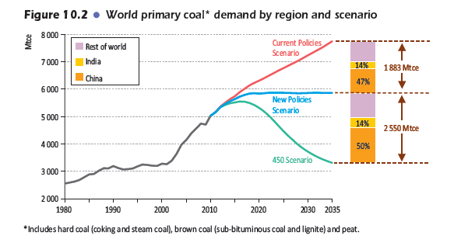
A word here on the climate change problem [re Denniston, Southland lignite]
Here’s the IEA’s projection of what has to happen to global coal use to stay with a 450 ppm target:
International Energy Agency World Energy Outlook 2011 p.356.

Slide 15
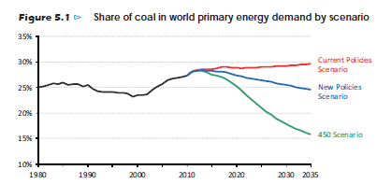
International Energy Agency World Energy Outlook 2012 p.156.

Slide 16
Taking into account the carbon emissions embodied in exports adds 6 Mt to NZ’s contribution to world GHG emissions
Data from NZ inventory tables for UNFCCC, http://www.mfe.govt.nz/publications/climate/greenhouse-gas-inventory-2011/index.html

Slide 17
The same issue arises with oil exports
But not with natural gas unless we get into LNG exports

Slide 18
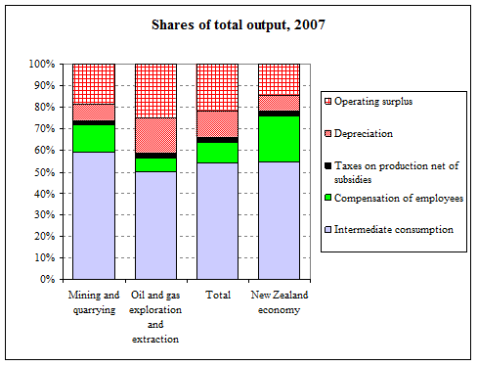

Slide 19
Less employment and labour income per dollar than other sectors
Gross operating surplus (returns on, and of, capital invested) accounts for around 35-40% of mining output, compared with only about 20% for the national economy as a whole.
“Compensation of employees” accounts for les than 10% of output in mining, against 20% of total output across the overall New Zealand economy.
The labour share in mining has fallen dramatically since the 1970s. Incomes generated in mining, in short, are heavily skewed towards operating surplus.
gross operating surplus, which takes just under half of gross value added across the whole economy, takes between 70% and 80% in mining .
Compensation of employees takes 47% of gross value added across the economy, but only 20% in mining
Depreciation is 7% of gross output nationwide, whereas for mining it has ranged between 12% and 20% over the past two decades. Using gross value added (including depreciation) rather than net value added (excluding depreciation) as the measure of “contribution to the economy” makes mining appear more productive than it actually is in adding value to the intermediate inputs used

Slide 21
March year 2007 data or estimates |  |  |  | Mining (ANZSIC Division B) | ANZSIC Level 2 |  | ANZSIC level 3
 |  |  |  |  | Oil and gas | Mining and quarrying (incl services to mining) | Quarrying | Coal | Gold & silver | Ironsands | Total mining and quarrying | Services to mining estimates
Percentage shares of gross value added
 | Compensation of employees |  |  | 21.0% | 12.7% | 31.8% | 34.6% | 35.0% | 21.7% | 57.1% | 32.4% | 29.3%
 | Taxes on production incl ERL |  |  | 4.6% | 10.7% | 4.9% | 0.0% | 4.1% | 0.0% | 0.3% | 1.4% | 13.1%
 | Gross operating surplus |  |  | 74.4% | 82.5% | 63.9% | 65.0% | 60.8% | 78.3% | 42.9% | 66.0% | 56.9%
 |  | Depreciation |  | 26.3% | 32.6% | 18.2% | 15.9% | 20.1% | 46.1% | 3.5% | 24.1% | 14.3%
 |  | Net surplus |  | 48.1% | 49.9% | 45.8% | 49.1% | 40.8% | 32.2% | 42.9% | 42.1% | 42.6%
 |  |  | Income tax and royalties | na | na | na | 14.7% | 16.7% | 8.3% | 0.3% | 13.4% | 12.8%
 |  |  | After-tax net surplus | na | na | na | 34.4% | 24.1% | 23.9% | 42.9% | 28.7% | 29.8%
Percentage shares of gross output
 | Intermediate purchases |  |  | 54.5% | 50.2% | 59.1% | 56.3% | 68.4% | 41.1% | 56.3% | 68.4% | 41.1%
 | Gross value added |  |  | 45.5% | 49.9% | 40.9% | 43.7% | 31.6% | 52.5% | 43.7% | 31.6% | 52.5%
 | Compensation of employees |  |  | 9.5% | 6.3% | 13.0% | 15.1% | 11.1% | 11.4% | 24.9% | 13.0% | 13.0%
 | Taxes on production incl ERL |  |  | 2.1% | 5.3% | 2.0% | 0.0% | 1.3% | 0.0% | 0.1% | 0.6% | 5.8%
 | Gross operating surplus |  |  | 33.9% | 41.1% | 26.1% | 28.4% | 19.2% | 41.1% | 18.7% | 26.5% | 25.3%
 |  | Depreciation |  | 12.0% | 16.3% | 7.4% | 7.0% | 6.3% | 24.2% | 1.5% | 9.6% | 6.3%
 |  | Net surplus |  | 21.9% | 24.9% | 18.7% | 21.4% | 12.9% | 16.9% | 18.7% | 16.9% | 18.9%
 |  |  | Income tax and royalties | na | na | na | 6.4% | 5.3% | 4.4% | 0.1% | 5.4% | 5.7%
 |  |  | After-tax net surplus | na | na | na | 15.0% | 7.6% | 12.6% | 18.7% | 11.5% | 13.2%

Slide 22
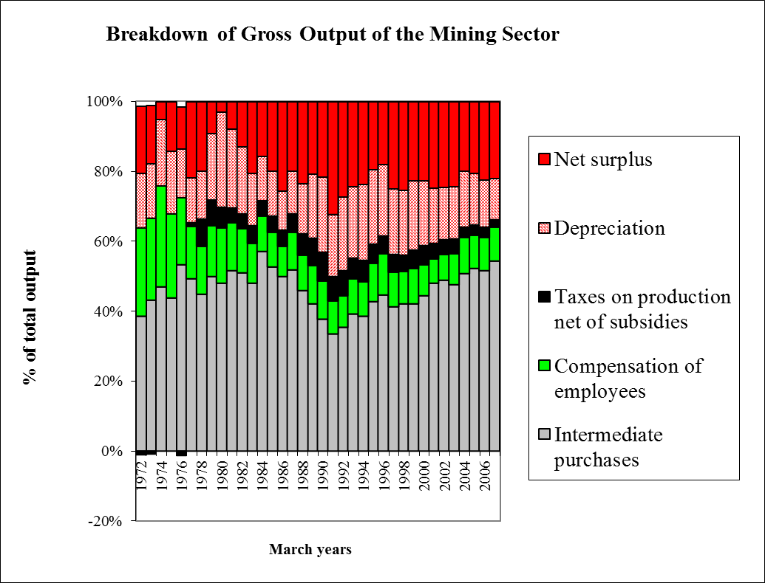
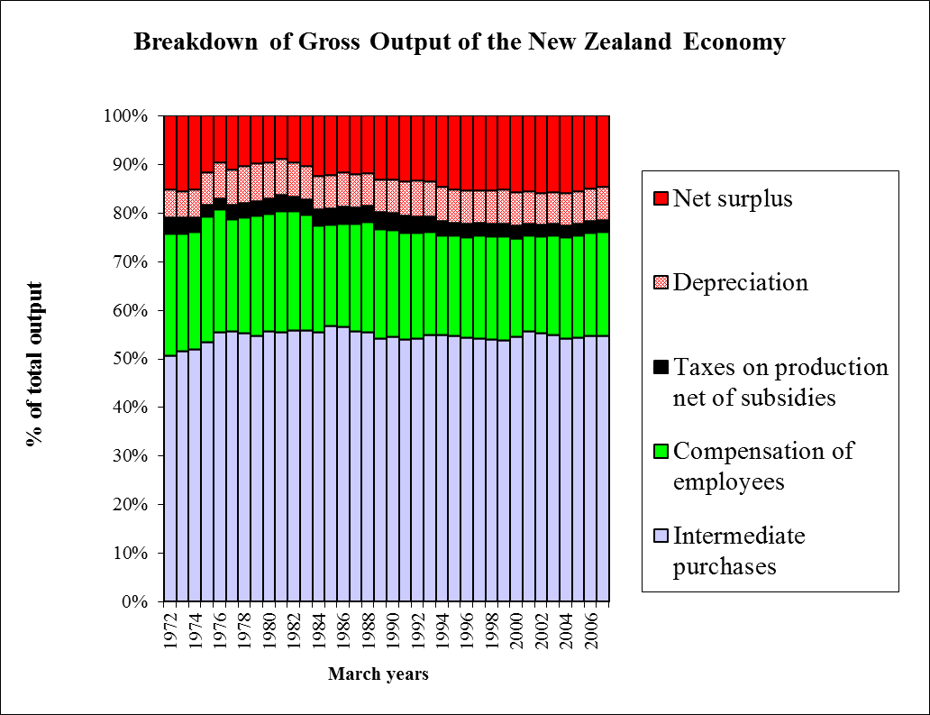
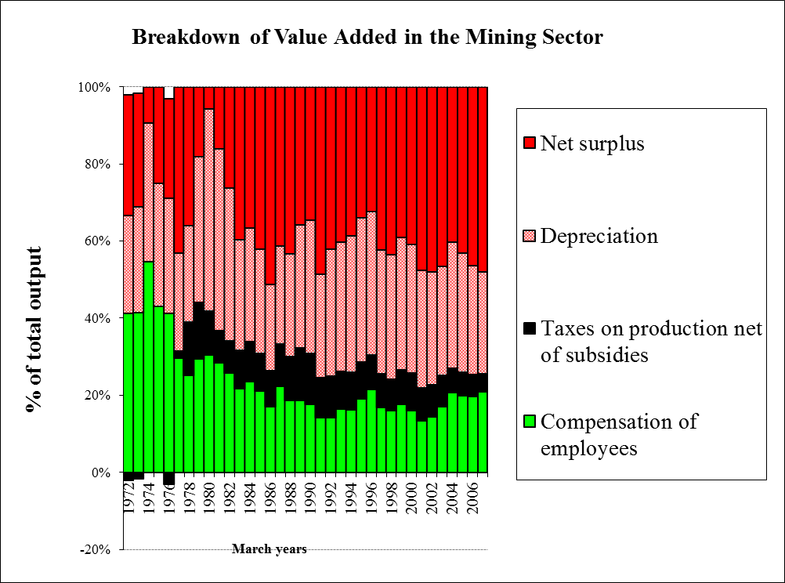
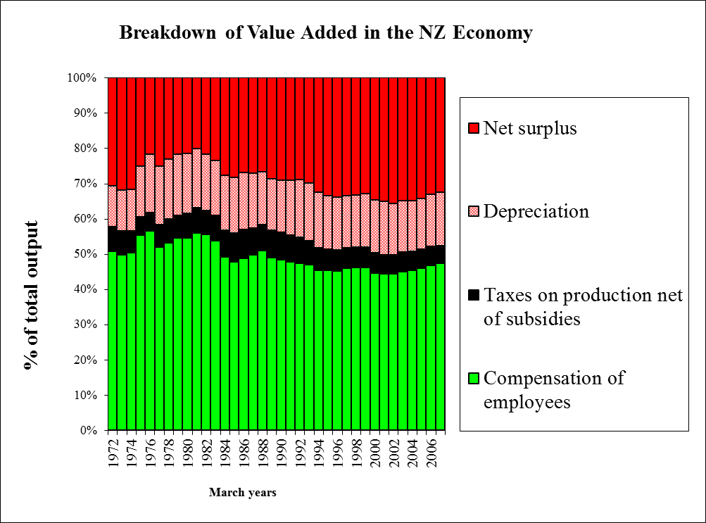

Slide 23
Now, some basic economics
What follows is from W.J. Baumol and David F. Bradford, “Detrimental externalities and non-convexity of the production set”, Economica 39(154):160-176, May 1972.
If you’ve studied a course using W.J. Baumol and W.E. Oates, The Theory of Environmental Policy, 2ed, Cambridge University Press, 1988, Chapter 8 then you’ll recognise it.

Slide 24
Suppose we have an economy allocating scarce resources between two outputs, mapped onto two axes of a diagram
Timber
Production possibility frontier
Pulp and paper

Slide 25
This is the “convex” case that economists love because the market can solve the allocation problem: once the relative prices are known the efficient quantities are at point A
Timber
A
Relative price slope
Pulp and paper

Slide 26
Convexity means you can strike an efficient balance between the two alternative uses of the resource(s). But with negative externalities you can’t assume convexity. Consider this case:
Clean water
Is the technical trade-off in production like this?
So long as clean water is unpriced and has no market the relative-price signals that prevail are skewed in favour of dairying
But a balance can be struck that recognises the externality by an administrative limit on dairying, and/or a tax on effluent is potentially an efficient policy instrument
High-effluent dairying

Slide 27
Convexity means you can strike an efficient balance between the two alternative uses of the resource(s). But with externalities you can’t assume convexity. Consider this case:
Clean water
Or like this?
Bang-bang: here there is a critical price relativity and the market route gives you a stark choice, one or the other but not both… With clean water unpriced, the risk of losing it altogether to rampant dairying is raised
Basically someone has to make a planning decision here about the relative amounts – resource management planning comes to the fore
High-effluent dairying

Slide 28
Convexity means you can strike an efficient balance between the two alternative uses of the resource(s). But with externalities you can’t assume convexity. Consider this case:
Clean water
Or like this?
Here the market can be worse than useless: the greater the curvature, the more likely the market will lead to a welfare minimum, not a maximum.
High-effluent dairying

Slide 29
There are extreme cases where the axes are the diagram. For example
GE-free agriculture
You can have either but not both
GM crops

Slide 30
So how about

Slide 31
100% Pure National Parks
Large-scale opencast mining

Slide 32
Freedom from oil spill risk
Offshore oil drilling

Slide 33
100% Pure National Parks
Large-scale opencast mining

Slide 34
Waihi residents’ enjoyment of life
Gold mining under Waihi

Slide 35
Recreational tourism on the ground
Helicopter trips over Franz Josef

Slide 36
Conservation values in a National Park
Skifield development on Ruapehu

Slide 37
Cost-benefit in these situations is an attempt to monetise as much as possible of the non-market values so that a one-for-one monetary criterion can apply
It can be useful when it produces lower-bound money estimates that rule out the market activity
Non-market values
But problematic when value is fully indeterminate, or when there’s downward bias in the valuation technique (e.g. WTP)
B
Market activity

Slide 38
In their original article, Baumol and Bradford noted the incompatibility between industrial waste dumping and clean environment
One simple solution, they said, is geographic separation
When one of the activities thrives on environmental degradation while the other requires a high-quality environment, optimal policy is to keep them physically separate:
“[S]ufficiently severe externalities make locational specialization economical. An example of the application of this point is seen in the Ruhr region in Germany, where the Emscher River valley has been completely devoted to waste disposal, while two other river basins have been preserved free from pollution”
“The danger of an incorrect choice by planners in this context appears clear. If it should turn out that, unpolluted, the Emscher River valley is uniquely well suited to growing marijuana it may turn out to have been a mistake to pick that one rather than one of the others for the area's sewer.”

Slide 39
Baumol and Bradford’s take-home point:
“In a world in which detrimental externalities are sufficiently severe to cause non-convexity of the social production possibility set, prices can no longer be depended upon to give us the right signals. Even if we know the entire set of feasible output vectors, equilibrium prices usually tell us nothing about the Pareto-optimality of current output or even the direction in which to seek improvement. … [T]he choice of the equilibrium point at which to settle must be made collectively...”

Slide 40
One outcome of Think Big was the Conservation Estate
Set up by the Conservation Act 1987. Lands in the estate are managed under the overriding principle of protection => national parks, Schedule 4 of the Crown Minerals Act…
Resource Management Act 1991 has the objective of “sustainable management” => looks for balance where possible

Slide 41
The central issue is the nature and scale of externalities
That can’t be answered by throwing huge dollar figures around, because many of the values at stake are not commensurable with money
Nor do techniques such as Contingent Valuation make them so, however helpful CV numbers may be as a prop for decisionmakers

Slide 42
Wilkin River case Southern Alps Air Limited v Queenstown Lakes District Council [2010] NZEnvC 132 (28 April 2010)

Slide 43
Mount Aspiring National Park Management Plan June 2011 p.20 “The Olivine Wilderness Area is a significant area of the park and is buffered by the remote zone. As required by legislation, tracks and huts are not provided and aircraft use for recreational users is not permitted in the wilderness area.”

Slide 44
The Think Big debates had two central foci
Economics of the project from the standpoint of the national interest
Inadequacy of public participation under the National Development Act (and the old Town and Country Planning Act), especially to protect non-market values of importance to New Zealanders
There’s some deja vue at present

